Slide 1
Update on Carbon Nanotubes and Related Nanofibers
To: Science Advisory Board
Date: 18 Nov 2020
By: Michael Ellenbecker, ScD, CIH

Slide 2
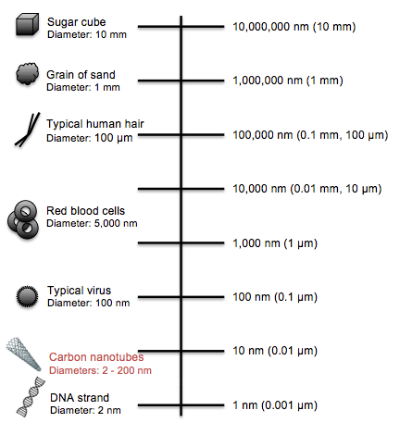
What is Nanotechnology
The study of the controlling of matter on an atomic and molecular scale
Engineered nano objects: at least one dimension between 1 to 100 nanometers (nm)
  roughly 100,000 times smaller than the diameter of a human hair
Nano-objects

Slide 3
R&D and Use – Spanning multiple technology sectors
Nanotechnology
Aerospace
Food and agriculture
Medicine
Bio-technology
Energy/ Env
Trans-portation
National security
Advanced materials/textiles
Cosmetics

Slide 4
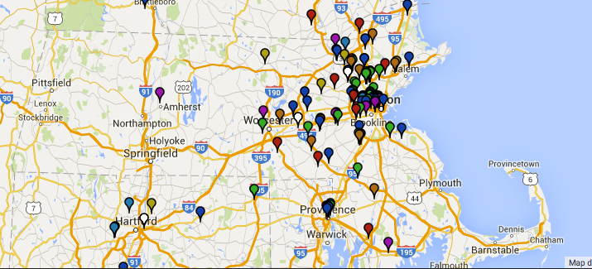
Nanotechnology in the Commonwealth
According to Nanowerk, currently there are 68 companies in MA “with a nanotechnology focus”
https://www.nanowerk.com/nanotechnology/Nanotechnology_Companies_Research_and_Degree_Programs_in_Massachusetts.php
MA is among the top 5 in the country for commercial and R&D activity on nanomaterials/nanotechnology

Slide 5
Types of Engineered Nanomaterials
Broad Categories: Engineered Nanomaterials
Carbon-based
fullerenes, carbon nanotubes
Metal
Silver, gold, copper
Metal Oxides
Titanium dioxide, zinc oxide, iron oxide
Dendrimers
Hyperbranched polymers, dendrigraft polymers, dendrons
Composites
Nano clays, polymer beads

Slide 6
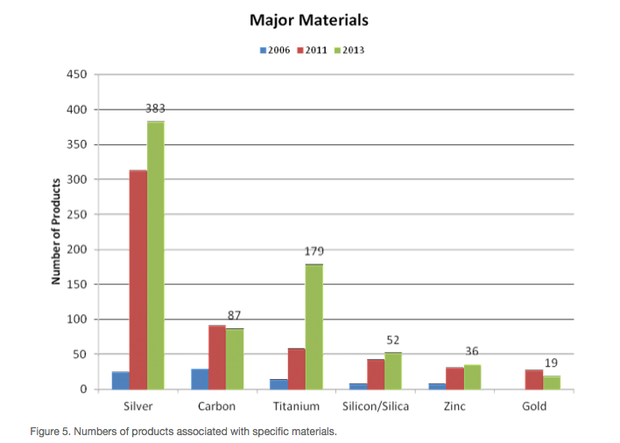
Engineered nanomaterials in consumer products (Source: Project on Emerging Technologies, Consumer Products Inventory, 2013)
http://www.nanotechproject.org/cpi

Slide 7
Engineered nanomaterials: enhanced performance compared to their bulk counterparts
At nano-scale:
  material properties change - melting point, fluorescence, electrical conductivity, and chemical reactivity
  Surface size is larger - more material comes into contact with surrounding materials and increases reactivity
Nanoscale performance benefits
More reactive
Stronger
Lighter
Better electrical conductivity
More durable

Slide 8
Physical-chemical properties: key to performance AND inherent hazard
Can we tune these properties to enhance their technological benefit AND reduce their potential hazard to ensure the safe development and use of engineered nanomaterials?
Physicochemical characteristics governing inherent hazard of ENM
Chemical composition
Surface area
Shape
Aspect ratio
Size
Chemical surface coatings
Reactivity

Slide 9
Overview: Carbon Nanotube Environmental and Occupational Health and Safety
te

Slide 10
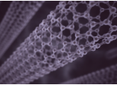
Engineered Carbon Nanotubes – What are They?
Divided into 2 broad categories:
  Single-walled CNTs (SWCNTs)
  Multi-walled CNTs (MWCNTs)
Carbon nanofibers (CNFs) – similar but cylinders are not perfectly formed
Important: CNTs/CNFs are not a single material. ~50,000 SWCNTs and likely even more potential combinations of MWCNTs
  Vary based on size, shape, chemical composition, reactivity, etc.
Notes:
Engineered carbon nanotubes What are they? Carbon nanotubes or CNTs are one class of nanomaterials, which most of you likely know are materials that are 1 billionth of a meter in any one dimension. These engineered nanomaterials are hexagonal sheets of carbon or graphite that resemble miniscule rolls of chicken wire. Most reports attribute our discovery of CNTs to 1991 when Japanese scientist working for the NEC Corp. described “nanometer-sized needle-like tubes of carbon” in the a paper published in the prestigious journal, Nature.
We’re specifically talking about engineered carbon nanotubes in this report. We’ve also discovered recently that carbon nanotubes can be produced in situations were there are extremely high temperature and the presence of metals, such as in volcanic eruptions.
There are 2 general categories of carbon nanotubes. (1) Single-walled carbon nanotubes were are simply a single layer of the hexagonal sheet that you see to the right. These usually have diameters of only a few nanomaters. Multi-walled carbon nanotubes are larger – envision multiple tubes inside one another. They have larger diameters ranging from 5 nm to 200 nm. While the diameters of carbon nanotubes are in the nanoscale range, their lengths can be thousands of times longer…in the micrometer range.
It’s really important to note that CNTs are not a single material. There are tens of thousands of variations based on differences in physical or chemical characteristics, such as size, shape, surface chemistry, reactivity among others. This will be a key issue that will come up again and again in the themes of our report (and in the science on CNTs) that impact our understanding of health effects and policy approaches for ensuring protections.

Slide 11
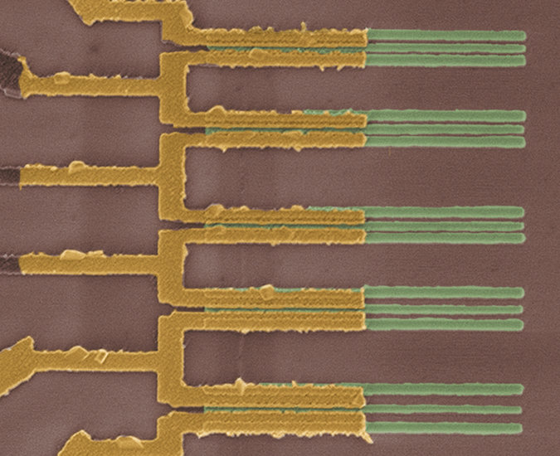
New York Times, 1 Oct 2015
“IBM Scientists Find New Way to Shrink Transistors”
CNT field effect transistors
Increase speed and/or reduce power use by a factor of 7

Slide 12
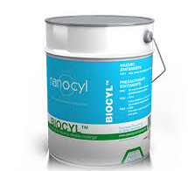



Emerging as substitutes for toxic chemicals
Anti-fouling marine paints
[substitutes for tributyltin, copper boat paints, etc]
Flame retardants for electronics, wire/cable, textiles, foams [substitutes for halogenated flame retardants]

Slide 13
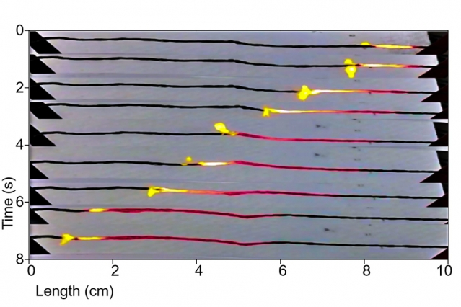
Journal of Cleaner Production, 2017:
Carbon nanomaterials as potential substitutes for scarce metals. Rickard Arvidsson, A. Bjorn
Chemical Reviews, 2014:
Safe Clinical Use of Carbon Nanotubes as Innovative Biomaterials
Naoto Saito et al.
Introducing Sugar-Coated Carbon Nanotubes – A Nontoxic Alternative Source of Power

Slide 14
CNT Toxicity
Many studies published in the last 20 years
Primary end points of concern:
  Pulmonary fibrosis – SWCNT, MWCNT, CNF
  Inflammation
    Lung tissue - SWCNT, MWCNT, CNF
    Cardiac tissue - SWCNT, MWCNT
Cancer - MWCNT
  Lung tumor promoter
  Mesothelioma
NIOSH 2013. Current Intelligence Bulletin 65, Occupational Exposure to Carbon Nanotubes and Nanofibers. Available at: http://www.cdc.gov/niosh/docs/2013-145/ pdfs/2013-145.pdf.

Slide 15
Cancer & MWCNTs
Tumor promotion [high aspect ratio MWCNTs]:
  mouse inhalation study, first exposed to methylcholanthrene (MCA) via intraperitoneal injection.
  Strong promotion of lung tumors [pulmonary adenomas and adenocarcinomas]
  Strong promotion of malignant serosal tumors consistent with sarcomatous mesothelioma
Sargent LM, et al. Part Fibre Toxicol. 2014 Jan 9;11:3. doi: 10.1186/1743-8977-11-3.

Slide 16
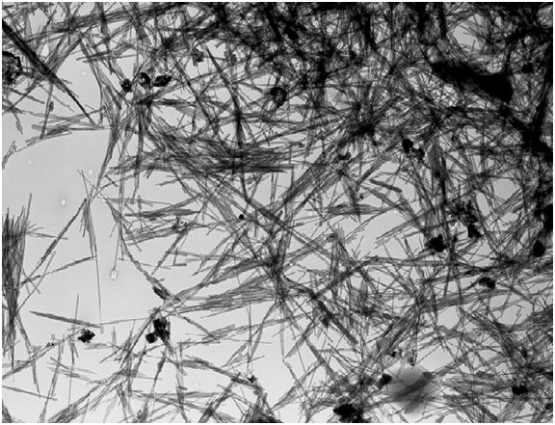
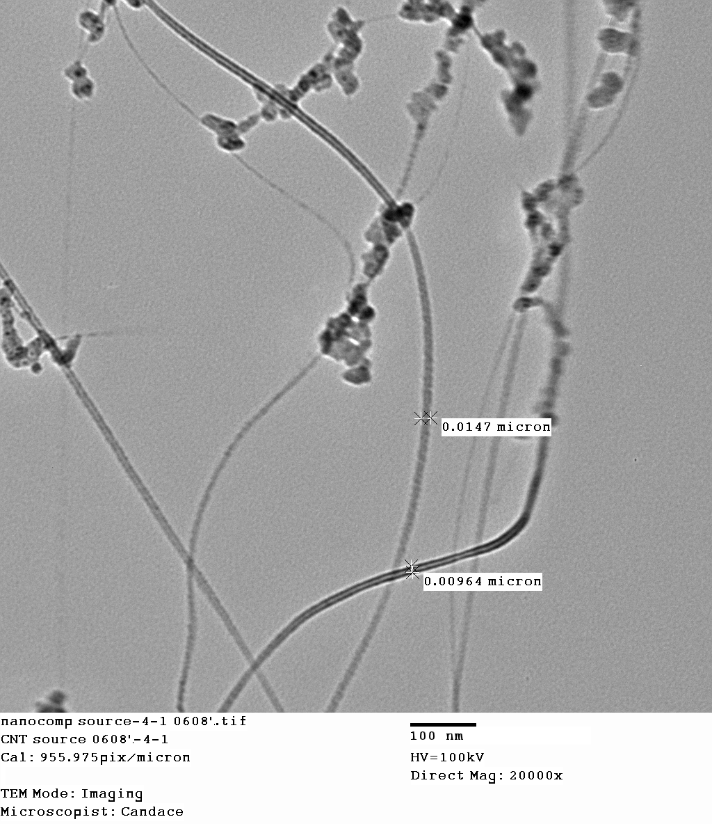
Asbestos
CNTs

Slide 17
CNTs cause Mesothelioma?
Carbon nanotubes introduced into the abdominal cavity of mice show asbestos-like pathogenicity in a pilot study, Poland, et al., Nature Nano., 2008.
Induction of mesothelioma in p53+/- mouse by intraperitoneal application of multi-wall carbon nanotube, Takagi, et al., J. Toxicol. Sci, 2008.

Slide 18
Mercer, et al., Distribution and persistence of pleural penetrations by multi-walled carbon nanotubes, Part. Fibre Tox., 2010.
Notes:
Figure 7 Representative micrographs of MWCNT in subpleural tissues, visceral pleura and pleural space. In all four panels, the visceral
pleural surface runs along the top of each micrograph. The FESEM image in A shows a MWCNT loaded alveolar macrophage in an alveolus
immediately beneath the visceral pleura surface. The right side of the image shows a single MWCNT fiber penetrating the alveolar epithelium
into the subpleural tissues (80 μg dose, 28 day post-aspiration). Figure 7B shows a dilated subpleural lymphatic vessel which contains a
mononuclear inflammatory cell that is penetrated by several MWCNT fibers (80 μg dose, 56 day post-aspiration). A MWCNT penetrating the
visceral pleura is shown in the light micrograph of 7C with a MWCNT-loaded alveolar macrophage visible in the left side of the micrograph (80
μg dose, 28 day post-aspiration). A single MWCNT penetrating from the subpleural tissue through the visceral pleura into the pleural space is
shown in the FESEM image of 7 D (80 μg dose, 56 day post-aspiration).

Slide 19
CNTs cause Mesothelioma?, Cont.
Poland: “Here we show that exposing the mesothelial lining of the body cavity of mice, as a surrogate for the mesothelial lining of the chest cavity, to long multiwalled carbon nanotubes results in asbestos-like, length-dependent, pathogenic behaviour… Our results suggest the need for further research and great caution before introducing such products into the market if long-term harm is to be avoided.”
Dec 2014 – IARC designates “certain MWCNTs” as 2B, Possible Human Carcinogen
Grosse Y et al. Lancet Oncol. 2014;15(13): 1427-28.

Slide 20
Fiber Morphology Important
In animal studies thus far:
  SWCNTs do not cause mesothelioma
  Thin (d < 15 nm) MWCNTs – ditto
  Thick (d > 150 nm) MWCNTs – ditto
But – all commercially available MWCNTs : 15 nm < d < 150 nm
Short (L < 1-5 µm) MWCNTs – ditto
Can we make them all short?

Slide 21
Functionalization can affect Length
Ali-Boucetta, et al., Angew. Chem. Int. Ed. 2013, 52, 2274 –2278, DOI: 10.1002/anie.201207664

Slide 22
Human Studies
Few human studies to date
  Case reports of CNTs found in the lungs of 911 first responders
  Recent case-control study revealed MWCNT manufacturing workers (levels 3x above the NIOSH REL) found biomarkers of effect similar to conclusions from tox studies
    increase in serum & sputum inflammatory & fibrotic biomarkers[ IL-1β, IL6, TNF-α, inflammatory cytokines, KL-6, TGF-β1]
Wu, M. et al . Environ. Health Perspect. 2010. 118: 499–504.
Fatkhutdinova LM et al. Toxicol and App Pharmacol. 2016; 299: 125–131

Slide 23
“Carbon nanotube and nanofiber exposure and sputum and blood biomarkers of early effect among U.S. workers,” John D. Beard, et al. (NIOSH), Env. Int. 116:214-228 (2018).
  We evaluated carbon nanotube/nanofiber (CNT/F) exposure in relation to biomarkers.
  We assessed CNT/F exposure via personal breathing zone, filter-based air sampling.
  We measured fibrosis, inflammation, oxidative stress, cardiovascular biomarkers.
  Inhalable rather than respirable CNT/F was more often associated with biomarkers.
  Sixteen biomarkers were associated with at least three CNT/F exposure metrics.

Slide 24
Emerging Ecotoxicity Concerns
Daphnids (Daphnia magna)
  Interferes with food uptake & movement at low concentrations [MWCNTs & SWCNTs]; More toxic with longer exposures; Impaired growth and reproduction at very low levels
Juvenile rainbow trout (Oncorhynchus mykiss)
  Systemic toxicity at very low levels (consistent with GHS classification of “extremely toxic to aquatic life)
Powerful anti-microbial agent
  Implications for sewage treatment plants
  *variation in findings given differing physicochemical characteristics
Source: Petersen, et al. Env Sci Technol 2011; 45(23):9837-9856.

Slide 25
Setting Occupational Exposure Limits
No consensus between different groups
Basic difference: mass concentration vs. number concentration
Mass concentration – easier, cheaper to measure
Number concentration – more relevant biologically (e.g., asbestos), lower LOD

Slide 26
NIOSH REL for CNT/CNF
NIOSH CIB 65
REL = 1 µg/m³ of respirable elemental carbon as an 8-h TWA
Elemental carbon is readily measured using NIOSH Method 5040
1 µg/m³ is the limit of quantification for Method 5040

Slide 27
NIOSH REL for CNT/CNF, Cont.
“Recent observations indicate that exposure to CNF can cause respiratory effects similar to those observed in animals exposed to CNT”
Because of residual risk at the REL, “NIOSH recommends that exposures to CNT and CNF be kept below the recommended exposure limit”

Slide 28
Agency or Company | Occupational Exposure Limit
 | Mass Concentration (µg/m³) | Number Concentration (f/cm³)
British Standards Institute |  | 0.01
Bayer Schering Pharmaceuticals | 50*
Japanese National Institute of Advanced Industrial Science and Technology | 30 (SWCNT)* 80 (MWCNT)*
Swiss Accident Insurance Funds |  | 0.01
German Institute for Occupational Safety and Health |  | 0.01
National Institute for Occupational Safety and Health U.S. | 1 (elemental carbon)*

Slide 29
BUT……
Depending on CNT fiber dimensions, 1 µg/m³ can correspond to number concentrations ranging from 0.01 f/cm³ (extremely large CNF) to 300,000 f/cm³ (typical CNT)
BSI – 0.01 f/cm³

Slide 30
TURA Program Resources
Nanomaterials Fact Sheet
Nanomaterials EH&S Library Guide
TURI Webpage on Nanomaterials
TURI Library
  Books
  Reports
  Databases

Slide 31


